Slide 1
Big(ger) Data
SI 618
Dr. Chris Teplovs
Univerity of Michigan School of Information

Slide 2
Overview
check-in
questions about homework, machine learning, etc.
a quick detour:
git
github
docker
binder
dask
dataframes

Slide 3
Check-in

Slide 4
Questions about homework, ML, etc

Slide 5
A quick detour
git
github
docker
binder

Slide 6
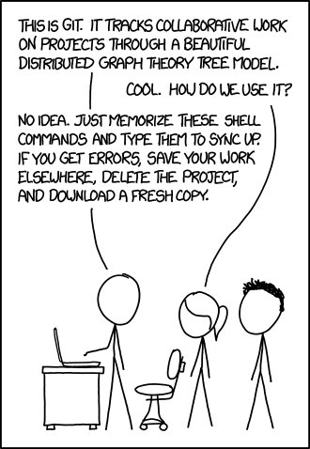
git
distributed version control
really great for many languages
(but sometimes not really great for Jupyter notebooks)

Slide 7
github
a convenient cloud-based solution to sharing git repositories (repos)
see, for example, umpy
see also, https://github.com/umsi-data-science/si618wn23 (and https://github.com/umsi-data-science/data)
Jupyter notebooks can be viewed automatically using nbviewer (which doesn't always work)
wouldn't it be great if we could have an interactive environment based on the contents of a repo?

Slide 8
docker
From Wikipedia:
Docker is a set of platform as a service products that use OS-level virtualization to deliver software in packages called containers. Containers are isolated from one another and bundle their own software, libraries and configuration files; they can communicate with each other through well-defined channels.
www.docker.com

Slide 9
binder: turn a git repo into a collection of interactive notebooks
add a few configuration files to your repo, point binder at your repo and enjoy (after a small wait)!

Slide 10
dask: parallel processing with python
uses concepts of Directed Acyclic Graph (DAG) computational engine and parallel processing to solve memory- and compute-bound problems
easy-to-use parallel equivalents of pandas DataFrames (called, unsurprisingly, Dask DataFrames)
also provides primitive interface (delayed objects), Dask Arrays (like numpy arrays), Dask Bags (like iterators, toolz, and pyspark), and futures interface (like promises)

Slide 11
How do each of these "scale up" to handle big(ger) data?
pandas for manipulating data
matplotlib & seaborn for visualization
nltk for text processing

Slide 12
Big Data
three Vs:
volume
velocity
variety
how can we handle big data?

Slide 13
Two ways to scale
vertically
get a more powerful machine
horizontally
get more machines
and get them to divide up the work
and get them to talk to each other
and assemble the results
alternatively, use your existing machine to its full capabilities

Slide 14
Multithreading
python supports the idea of multithreading: running multiple processes or threads simultaneously
(note that processes and threads are technically different, but the differences are not particularly important to what we're doing in this course)
similar idea to running multiple programs, but multiple threads share same data space as the main thread and can therefore access the same data
there are many ways to spawn multiple threads, many of which are relatively "low-level"
we're going to focus on higher-level abstractions of threads, so we don't have to get bogged down in the details of handling thread execution

Slide 15
Focus on pandas
let's take a closer look at how we might scale up pandas dataframes using horizontal scaling

Slide 16
Dask
"Dask is a flexible library for parallel computing in Python"

Slide 17
Dask
Dask is composed of two parts:
Dynamic task scheduling optimized for computation. This is similar to Airflow, Luigi, Celery, or Make, but optimized for interactive computational workloads.
“Big Data” collections like parallel arrays, dataframes, and lists that extend common interfaces like NumPy, Pandas, or Python iterators to larger-than-memory or distributed environments. These parallel collections run on top of dynamic task schedulers.

Slide 18
Dask principles
Familiar: Provides parallelized NumPy array and Pandas DataFrame objects
Flexible: Provides a task scheduling interface for more custom workloads and integration with other projects.
Native: Enables distributed computing in pure Python with access to the PyData stack.
Fast: Operates with low overhead, low latency, and minimal serialization necessary for fast numerical algorithms
Scales up: Runs resiliently on clusters with 1000s of cores
Scales down: Trivial to set up and run on a laptop in a single process
Responsive: Designed with interactive computing in mind, it provides rapid feedback and diagnostics to aid humans

Slide 19
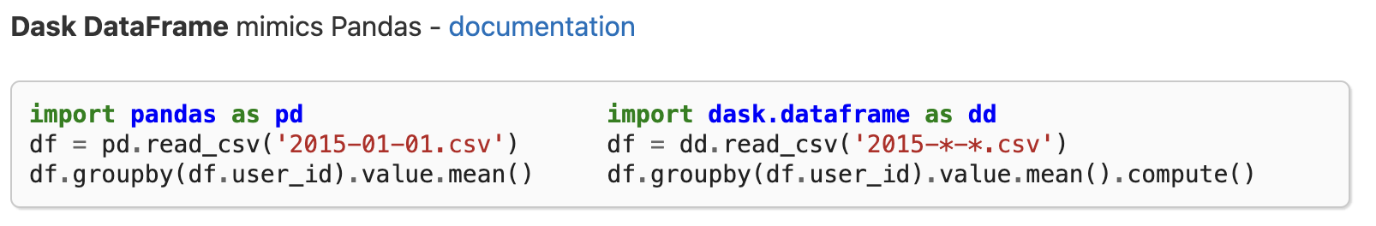
Not difficult (mostly) if you know pandas (which you do)

Slide 20
Easy to install
pip install h5py scikit-image graphviz dask[complete]

Slide 21
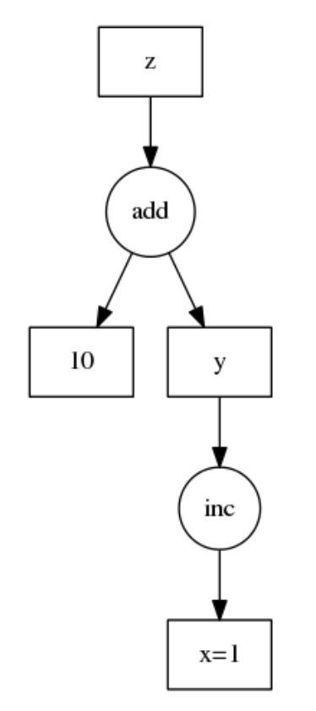
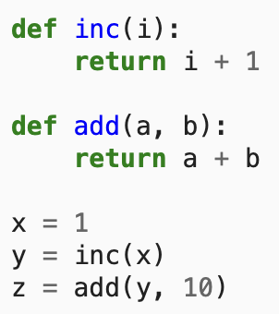
Task graphs
dask represents parallel computation as a directed acyclic graph

Slide 22
But that's low-level stuff – what about DataFrames?
Dask DataFrame is used in situations where Pandas is commonly needed, usually when Pandas fails due to data size or computation speed:
Manipulating large datasets, even when those datasets don’t fit in memory
Accelerating long computations by using many cores
Distributed computing on large datasets with standard Pandas operations like groupby, join, and time series computations
Dask DataFrame may not be the best choice in the following situations:
If your dataset fits comfortably into RAM on your laptop, then you may be better off just using Pandas. There may be simpler ways to improve performance than through parallelism
If your dataset doesn’t fit neatly into the Pandas tabular model, then you might find more use in dask.bag or dask.array
If you need functions that are not implemented in Dask DataFrame, then you might want to look at dask.delayed which offers more flexibility
If you need a proper database with all that databases offer you might prefer something like Postgres

Slide 23
Let's take a look at dask using binder
(so you don't have to install anything)
https://github.com/dask/dask-tutorial (note: there is a limit (100) on the number of sessions that can be active at any given time)

Slide 24
Let's try out some dask!
Install dask on your laptop using the command below. Note that you may need to install additional libraries (your notebooks may fail with errors if they're missing). In particular, graphviz is needed for the .visualize() methods. The graphviz installation is a bit complicated by the fact that you need to have the graphviz executable installed as well as the python module).
pip install graphviz h5py dask[complete]
Download today's notebook (from Canvas) and open it.

